Slide 1
Data Storage

Slide 2


Storage in DBMSs
How to organize & store data?
Design decisions:
  What representations and data structures best support efficient manipulations of this data?
To understand why the DBMS applies specific strategies
  Must first understand how disks work

Slide 3
Disks and Files
DBMS stores information on (“hard”) disks.
Main memory is only for processing
This has major implications for DBMS design!
  READ: transfer data from disk to main memory (RAM).
  WRITE: transfer data from RAM to disk.
  Both are high-cost operations, relative to in-memory operations…

Slide 4


DBMS vs. OS? Who’s in Control
Cname
DBMS is in control of managing its data
  It knows more about structure
  It knows more about access pattern
cid=cid
sid=sid
name=“Mary”
Students
Takes
Courses

Slide 5
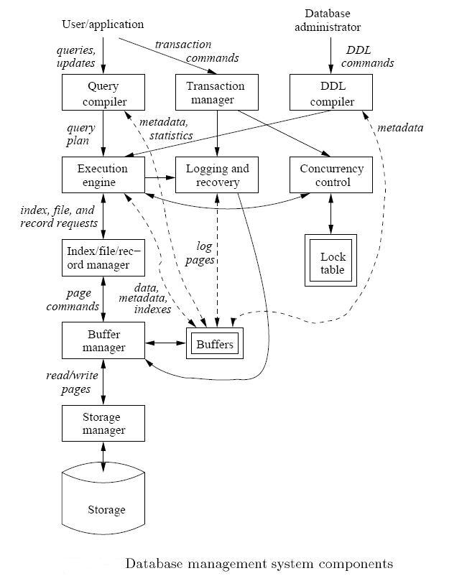
That is why DBMS has Storage Manager & Buffer Manager

Slide 6
Understanding Disks

Slide 7
Storage Hierarchy
Avg. Size: 256kb-1MB
Read/Write Time: 10⁻⁸ seconds.
Random Access
Smallest of all memory, and also the most costly.
Usually on same chip as processor.
Easy to manage in Single Processor Environments, more complicated in Multiprocessor Systems.
Avg. Size: 128 MB – 100s GB
Read/Write Time: 10⁻⁷ to 10⁻⁸ seconds.
Random Access
Becoming more affordable.
Volatile
Avg. Size: 100s GB- few TBs
Read/Write Time: 10⁻² seconds
NOT Random Access
Extremely Affordable: $0.68/GB!!!
Can be used for File System, Virtual Memory, or for raw data access.
Blocking (need buffering)
Avg. Size: 100s of Terabytes
Read/Write Time: 10¹ - 10² seconds
NOT Random Access, or even remotely close
Extremely Affordable: pennies/GB!!!
Not efficient for any real-time database purposes, could be used in an offline processing environment
Tertiary Storage
Slowest
Secondary Storage
Main Memory
Fastest
Cache (all levels)

Slide 8
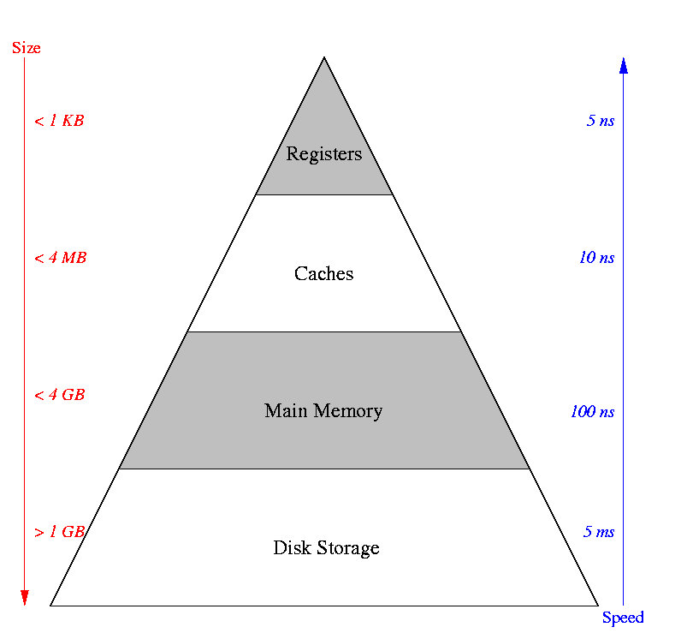
Storage Hierarchy
SSD

Slide 9
Why Not Store Everything in Main Memory?
Costs too much.
Main memory is volatile. We want data to be saved between runs. (Obviously!)
Typical hierarchy:
  Main memory (RAM) ⬅ Processing
  Disks (secondary storage) ⬅ Persistent Storage
  Tapes & DVDs ⬅ Archival
Notes:
19

Slide 10
Motivation
Consider the following algorithm :
For each tuple r in relation R{
Read the tuple r
For each tuple s in relation S{
read the tuple s
append the entire tuple s to r
}
}
What is the time complexity of this algorithm?

Slide 11
Motivation
Complexity:
  This algorithm is O(n²) ! Is it always ?
  Yes, if we assume random access of data.
Hard disks are not efficient in Random Access !
Unless organized efficiently, this algorithm may be much worse than O(n²).

Slide 12
Disks: Some Facts
Data is stored and retrieved in units called disk blocks.
  Disk block 512 bytes to 4K or 8K
Movement to main-memory
  Must read or write one block at a time
Notes:
20

Slide 13
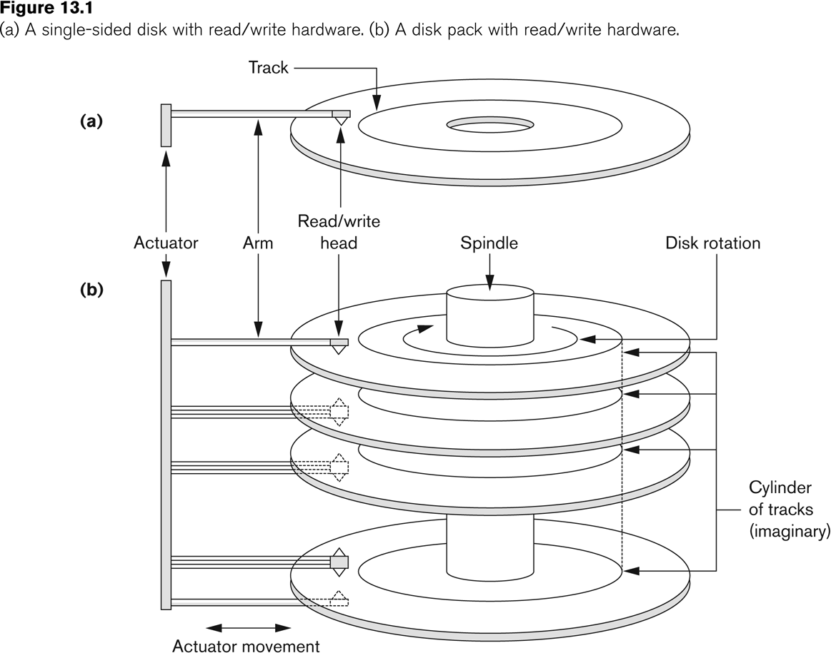
Disk Components
Platter
(2 surface)

Slide 14
Virtual Cylinder
Disk Head
Cylinder
Platter

Slide 15
Tracks divided into Sectors
Track
Gaps ≈ 10%
Sectors ≈ 90%
Sector
Gap

Slide 16
Movements
Arm moves in-out
  Called seek time
  Mechanical
Platter rotates
  Called latency time
  Mechanical

Slide 17
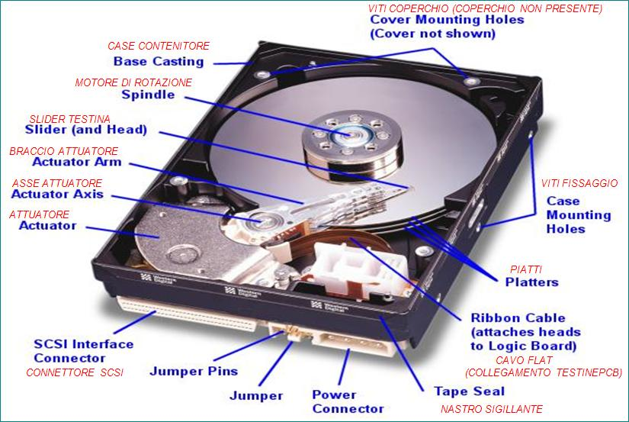
Actual Disk

Slide 18
Disk Controller
Processor
...
...
Memory
Disk Controller
Controls the mechanical movement
Transferring the data from disks to memory
Smart buffering and scheduling
Disk 1
Disk 2

Slide 19
How big is the disk if?
There are 4 platters
There are 8192 tracks per surface
There are 256 sectors per track
There are 512 bytes per sector
Remember 1kb = 1024 bytes, not 1000!
Size = 2 * num of platters * tracks * sectors * bytes per sector
Size = 2 * 4* 8192 * 256 * 512
Size = 2³³ bytes / (1024 bytes/kb) /(1024 kb/MB) /(1024 MB/GB)
Size = 2³³ = 2³ * 2³⁰ = 8GB

Slide 20
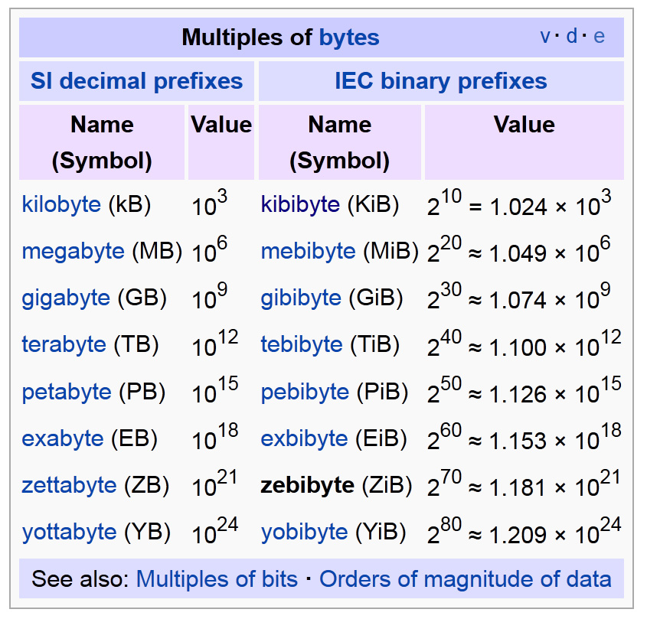
Scale of Bytes

Slide 21
More Disk Terminology
Rotation Speed:
  The speed at which the disk rotates: 5400RPM
Number of Tracks:
  Typically 10,000 to 15,000.
Bytes per track:
  ~10⁵ bytes per track

Slide 22
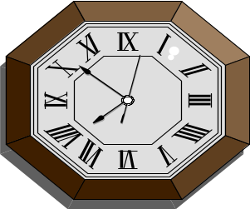
Big Question: What about access time?
I want
block X
block x
in memory
?
Time = Disk Controller Processing Time +
Disk Delay{seek & rotation} +
Transfer Time

Slide 23
Access time, Graphically
P
Disk Controller Processing Time
...
...
M
DC
Transfer Time
Disk Delay

Slide 24
Disk Controller Processing Time
Time = Disk Controller Processing Time
+ Disk Delay
+ Transfer Time
CPU Request → Disk Controller
  Nanoseconds (10⁻⁹)
Disk Controller Contention
  Microseconds (10⁻⁶)
Bus
  Microseconds (10⁻⁶)
≈ Microseconds
Negligible for our purposes.

Slide 25
Transfer Time
Time = Disk Controller Processing Time
+ Disk Delay
+ Transfer Time
Typically 10MB/sec
Reading 4K data block takes ~ 0.5 ms
Order of 1 millisecond (or less)

Slide 26
Disk Delay
Time = Disk Controller Processing Time
+ Disk Delay
+ Transfer Time
More complicated
Disk Delay = Seek Time +
Rotational Latency

Slide 27
Seek Time
Seek time is most critical time in Disk Delay.
Average Seek Times:
  Maxtor 40GB (IDE) ~10ms
  Western Digital (IDE) 20GB ~9ms
  Seagate (SCSI) 70 GB ~3.6ms
  Maxtor 60GB (SATA) ~9ms
Order of 10 milliseconds

Slide 28
Rotational Latency
Head Here
Block I Want

Slide 29
Average Rotational Latency
Average latency is about half of the time it takes to make one rotation.
3600 RPM = 8.33 ms
5400 RPM = 5.55 ms
7200 RPM = 4.16 ms
10,000 RPM = 3.0 ms (newer drives)
Order of few milliseconds

Slide 30
Accessing a Disk Block: Summary
Time to access (read/write) a disk block:
  seek time (moving arms to position disk head on track)
  rotational latency (waiting for block to rotate under head)
  transfer time (actually moving data to/from disk surface)
Key to lower I/O cost: reduce seek/rotation latency!
Notes:
22

Slide 31
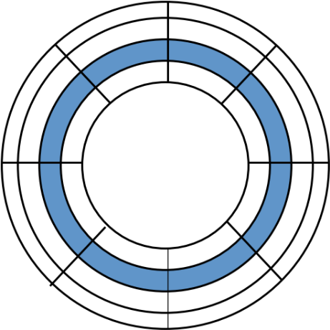
Example Disk Latency Problem
Calculate the Minimum, Maximum and Average disk latencies for reading a 4096-byte block on the same hard drive as before:
4 platters
8192 tracks
256 sectors/track
512 bytes/sector
Disk rotates at 3840 RPM
Seek time: 1 ms (warm-up) + 1ms for every 500 tracks traveled.
Reading one sector 0.06 ms
A 4096-byte block is 8 sectors
The disk makes one rotation in (1/64 sec) = 15.6 ms
Moving one track takes (1 + 0.002ms). Moving across all tracks takes
(1+ 16.4ms)

Slide 32
Best Case: Minimum Latency
Assume best case:
  head is already on block we want!
In that case, it is just read time of 8 sectors of 4096-byte block. We will pass over 8 sectors and 7 gaps.
That is only the “Transfer Time” ≈ 0.06 ms x 8 = 0.5 ms

Slide 33
Worst Case: Maximum Latency
Now assume worst case:
  The disk head is over innermost cylinder and the block we want is on outermost cylinder,
  block we want has just passed under the head, so we have to wait a full rotation.
Time = Time to move from innermost track to outermost track +
    Time for one full rotation +
    Time to read 8 sectors
    = 17.4 ms (seek time) + 15.6 ms (one rotation) + 0.5ms (transfer time)
    = 33.5 ms!!

Slide 34
Average Case: Average Latency
Now assume average case:
  It will take an average amount of time to seek, and
  block we want is ½ of a revolution away from heads.
Time = Time to move over tracks +
    Time for one-half of a rotation +
    Time to read 8 sectors
    = 9.2ms (approximation) + 7.8ms (half rotation) +
    0.5 ms (Transfer Time )
    = 17.5 ms

Slide 35
Writing Blocks
Same as reading blocks …

Slide 36
After seeing all of this …
Which will be faster Sequential I/O or Random I/O?
Sequential I/O
  Reading blocks next to each other on the same track
Sequential I/O saves seek & rotation latency times
Next Question: How to organize the data to avoid/reduce Random I/Os ?

Slide 37
Accelerating Access to Blocks

Slide 38
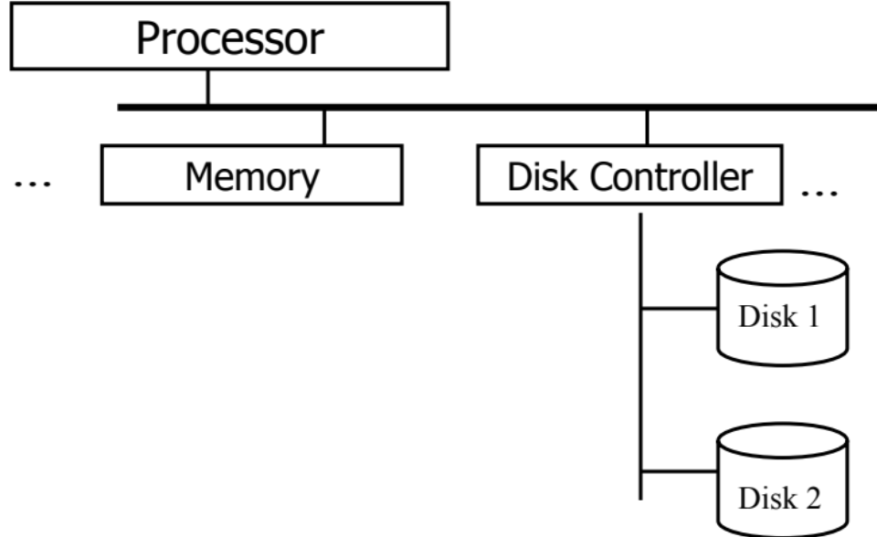
Accelerating Access to Blocks
Placing Related Blocks on Cylinders
Using Multiple Disks
Mirroring
Disk Scheduling
Prefetching & Buffering
Performed by Disk Controller

Slide 39
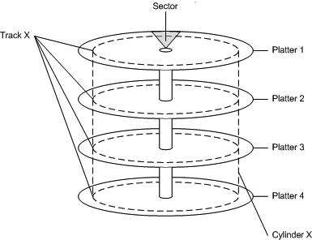
1- Placing Related Blocks on Cylinders
If blocks B1, B2, B3, and B4 will be read together
Put them on the same cylinder to read them at once.
Keep additional related blocks on the next sectors on the same track
B1
B2
B3
B4

Slide 40
2- Using Multiple Disks: Striping
Use multiple smaller disks instead of one large disk
Each disk can access its data independently
  N disks ➔ N times faster access
Disk 1
Disk 2
Disk 3
B1
B2
B3
B4
B5
B6

Slide 41
3- Mirroring
Use pairs of disks that are mirrors to each other
Good for failure & Good for faster access
Higher overhead under writing operations

Slide 42
4- Disk Scheduling
Disk Controller may have a sequence of block requests
Not necessary serve requests in their arrival order (FIFO) ➔ Use better scheduling policy
Elevator (SCAN) policies

Slide 43
4- Disk Scheduling: SCAN
Given the current requests in your queue
  The first one decides the direction (inward or outward)
  Check the queue and serve all those in your direction
While moving in a direction
  New requests are added to the queue without serving

Slide 44
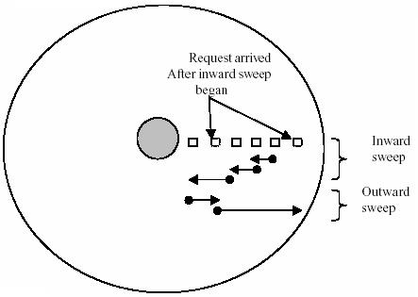
4- Disk Scheduling: SCAN
When starting a sweep (inward or outward)
  Complete the sweep until the end
  skip any newly arrived requests after the start

Slide 45

Accelerating Access to Blocks: Covered
Placing Related Blocks on Cylinders
Using Multiple Disks
Mirroring
Disk Scheduling
Prefetching & Buffering

